Slide 2
Simple problem
x1
x2

Slide 3
Simple problem
Training data:
1)
x1
x2

Slide 4
Simple problem
Training data:
1)
2)
x1
x2

Slide 5
Simple problem
Training data:
1)
2)
3)
x1
x2

Slide 6
Simple problem
Training data:
1)
2)
3)
4)
x1
x2

Slide 7
Simple problem
Training data:
1)
2)
3)
4)
5)
x1
x2

Slide 8
Simple problem
Training data:
1)
2)
3)
4)
5)
Global minimum

Slide 9




Method
Initial structures
Train
model
Consult DFT
Search ML potential

Slide 10
General method
1)
2)
3)
Initial structures
Train
model
Consult DFT
Search ML potential

Slide 11
General method
1)
2)
3)
Initial structures
Train
model
Consult DFT
Search ML potential

Slide 12
General method
1)
2)
3)
Initial structures
Train
model
x
x
x
Consult DFT
Search ML potential
x
x
x
x

Slide 13
General method
1)
2)
3)
Initial structures
Train
model
x
x
x
Consult DFT
Search ML potential
x
x
x

Slide 14
General method
1)
2)
3)
Initial structures
Train
model
x
x
x
Consult DFT
Search ML potential
x
x
x

Slide 15
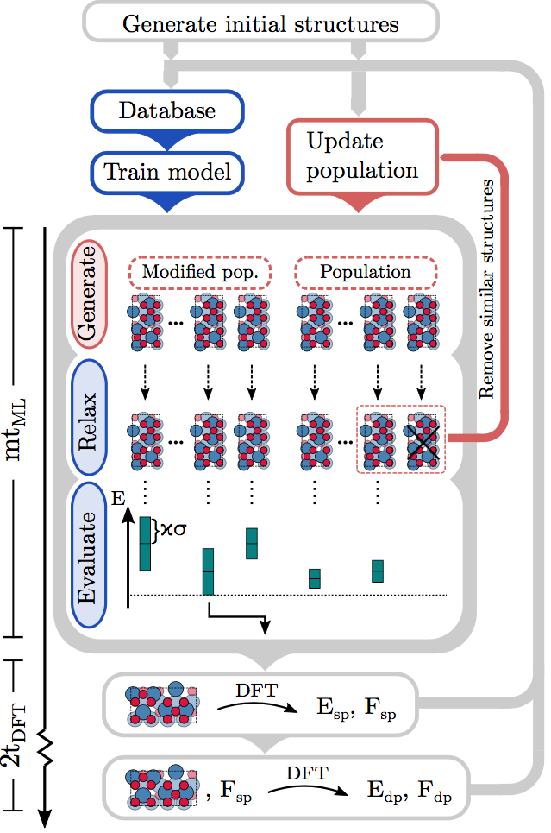
Method

Slide 16

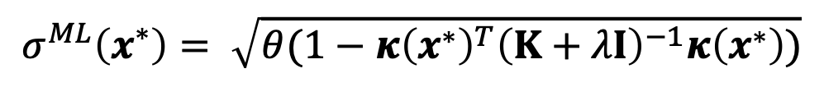
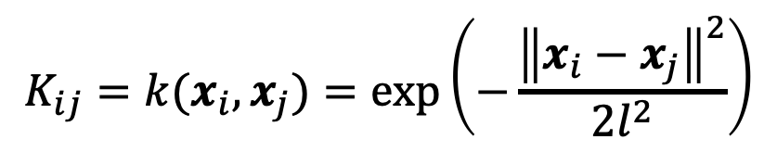

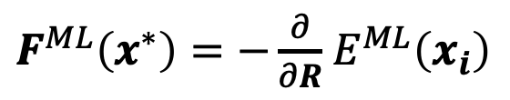
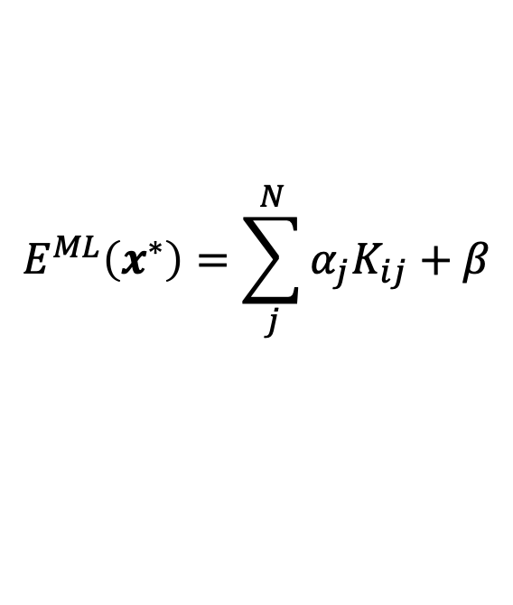

Gaussian process regression
Prediction:
Training:
$$E^{ML}\left(x^{∗}\right)=\sum_{j}^{N}{α_{j}K_{ij}+β}$$
$$α={\left(K+λI\right)}^{−1}E$$
$F^{ML}\left(x^{∗}\right)=−\frac{∂}{∂R}$ $E^{ML}\left(x_{i}\right)$
$$σ^{ML}\left(x^{∗}\right)= \sqrt{θ(1−{κ\left(x^{∗}\right)}^{T}{\left(K+λI\right)}^{−1}κ\left(x^{∗}\right))}$$
Kernel:
$$K_{ij}=k(x_{i},x_{j})=\exp\left(−\frac{{\left\|x_{i}−x_{j}\right\|}^{2}}{2l^{2}}\right)$$
$$κ\left(x^{∗}\right)=k(x^{∗}, X)$$

Slide 17
Gaussian process regression
Prediction:
Training:
$$E^{ML}\left(x^{∗}\right)=\sum_{j}^{N}{α_{j}K_{ij}+β}$$
$$α={\left(K+λI\right)}^{−1}E$$
$F^{ML}\left(x^{∗}\right)=−\frac{∂}{∂R}$ $E^{ML}\left(x_{i}\right)$
$$σ^{ML}\left(x^{∗}\right)= \sqrt{θ(1−{κ\left(x^{∗}\right)}^{T}{\left(K+λI\right)}^{−1}κ\left(x^{∗}\right))}$$
Kernel:
$$K_{ij}=k(x_{i},x_{j})=\exp\left(−\frac{{\left\|x_{i}−x_{j}\right\|}^{2}}{2l^{2}}\right)$$
$$κ\left(x^{∗}\right)=k(x^{∗}, X)$$

Slide 18
Gaussian process regression
Prediction:
Training:
$$E^{ML}\left(x^{∗}\right)=\sum_{j}^{N}{α_{j}K_{ij}+β}$$
$$α={\left(K+λI\right)}^{−1}E$$
$F^{ML}\left(x^{∗}\right)=−\frac{∂}{∂R}$ $E^{ML}\left(x_{i}\right)$
$$σ^{ML}\left(x^{∗}\right)= \sqrt{θ(1−{κ\left(x^{∗}\right)}^{T}{\left(K+λI\right)}^{−1}κ\left(x^{∗}\right))}$$
Kernel:
$$K_{ij}=k(x_{i},x_{j})=\exp\left(−\frac{{\left\|x_{i}−x_{j}\right\|}^{2}}{2l^{2}}\right)$$
$$κ\left(x^{∗}\right)=k(x^{∗}, X)$$

Slide 19
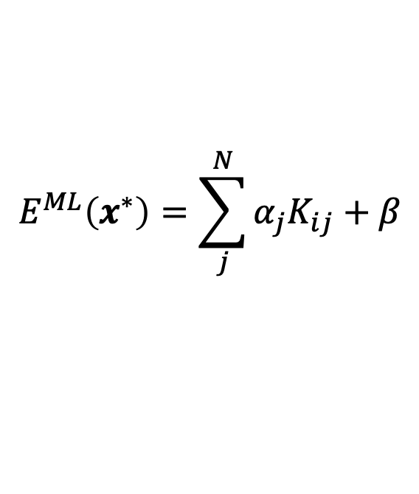
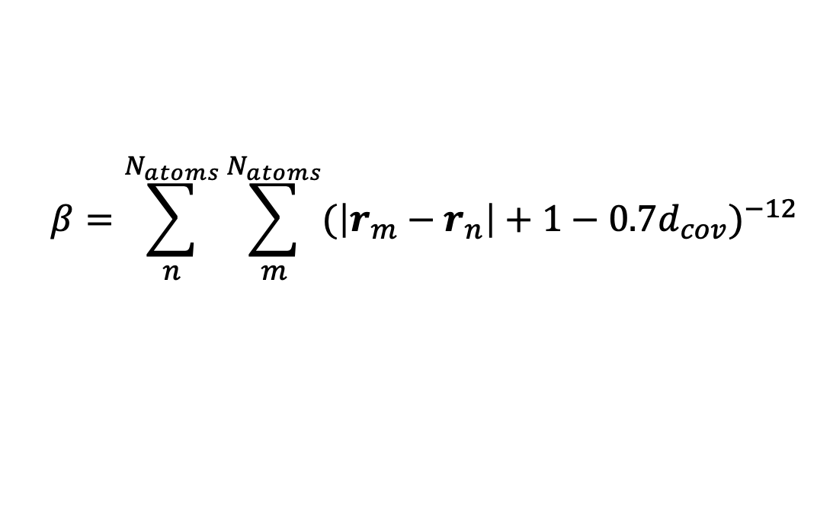
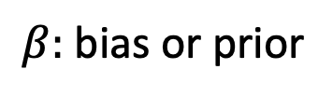
Delta Learning
Recall:
$$E^{ML}\left(x^{∗}\right)=\sum_{j}^{N}{α_{j}K_{ij}+β}$$
$β:$ bias or prior
Prior knowlegde: Atoms repel each other
Use:
$$β=\sum_{n}^{N_{atoms}}{\sum_{m}^{N_{atoms}}{{(\left|r_{m}−r_{n}\right|+1−{0.7d}_{cov})}^{−12}}}$$

